Slide 1

MX2020 Big Data
Data Leke Reference Architecture
Fraud Control
May 18, 2020

Slide 2
Change control
Versión | Fecha | Descripción del Cambio | Autor/Departamento
0.1 | 18/05/2020 | Creation of the document | [Big Data Architecture] Susana Edith Barrientos Galicia

Slide 3
Table of Contents
Features and terminology
Needs and Solution Proposal
Graphic Representation of the Solution
Infrastructure and Connectivity
General services
Risks and Dependencies
Standards, Patterns and Decisions of Architecture
References and Annexes

Slide 4
Features and terminology

Slide 5



Features and terminology (I)
Data Lake - Fraud Control
Data Sources
Acquisition & Ingest layer
Processing Layer
Abinitio
Raw
Curated
Augmented
Layers of Architecture of a Data Lake
Batch Layer
N... node
Functional division for the data life cycle
Hue
Hue
Sentry, Kerberos
UI Framework
SDK
Workflow
Workflow
Hive
Oozie
Scheduler
Metadata
Languages, Compilers
Fast read / write access
Flume, Sqoop
Pig / Hive
HBase
Data Integration
Components of the batch layer
HDFS
Hadoop Distributed File Systems
Job
Spark
Processing
YARN
Resources Manager
Zookeeper
Coordination
cloudera
Data Lake

Slide 6
Needs and Solution Proposal (I)
Descripción de la solución técnica
Objective
Define core components, pieces of code for the Data Lake Fraud Control project architecture
Scope
Represent graphics of the components, internal structure and integrations, incorporating the use of good design and development practices in the different phases of the software engineering process.
Description
Due to the reengineering of the Architecture of the Fraud Control area, the following functionalities for the Data Lake are identified:
Validate files (Existence and structure)
Clean Data (split |)
Move Row Zone data to Cured
Data quality
Process the data according to the business rules of the Fraud Control area, make a view available for the visualization tool
Create the views in Hive to be consumed by the visualization tool

Slide 7
Needs and Solution Proposal (I)
Descripción de la solución técnica
Prerequisites to the Data Lake process
Define core components, pieces of code for the Data Lake Fraud Control project architecture

Slide 8
Needs and Solution Proposal (II)
Descripción de la solución técnica - Activities
Activities and high-level estimation of the software engineering process
Define core components, pieces of code for the Data Lake Fraud Control project
Start
Data analysis (, define expected model)
Review current model
Define expected Model (Refine)
Prepare, review use cases
Prepare, review test cases
Design (Internal structure of the components)
Refine Architecture
Prepare diagrams of the functional flow of each component
Define the internal structure of the component and elaborate graphic representation
Validate the Architecture's fullness
Implementation
Validate unit tests
Functional and Non-Functional Tests
Deployment in different Environments
Validate in different environments
End

Slide 9
Needs and Solution Proposal (III)
Descripción de la solución técnica - Product baseline
PRODUCT REQUIREMENT NUMBER | RELATED REQ ID | PRODUCT REQUIREMENT BRIEF DESCRIPTION | PRODUCT REQUIREMENT DESCRIPTION | PRODUCT TYPE | PRODUCT REQUIREMENT LIFECYCLE | COMPLEXITY DESCRIPTION | ESTIMATED SIZE (COMPLEXITY POINTS) | ESTIMATED SIZE | REE | A&D | IMP | TST | DPY | ESTIMATED EFFORT | ESTIMATED EFFORT
1 | DESING-001 | PROD-PROC-001 | Revisar el modelo lógico y físico actual (AS-IS) y el esperado (TO-BE) de la base de datos de Fraud Control | PROCESS | DEVELOPMENT | SIMPLE | 12.07 | 12.07 | 1.267 | 3.380 | 12.673 | 2.746 | 1.056 | 21.12 | 21.12
2 | FUNCTIONALITY-001 | PROD-PROC-003 | Analizar, deseñar, constuir, probar y desplegar el componente ValidateEngine existencia y estructura de los archivos del Proyecto Fraud Control * | PROCESS | DEVELOPMENT | MEDIUM | 27.13 | 27.13 | 2.849 | 7.599 | 28.494 | 6.174 | 2.375 | 47.49 | 47.49
3 | FUNCTIONALITY-001 | PROD-PROC-003 | Analizar, deseñar, constuir, probar y desplegar el componente ProcesEngine existencia y estructura de los archivos del Proyecto Fraud Control | PROCESS | DEVELOPMENT | COMPLEX | 47.04 | 47.04 | 4.941 | 13.175 | 49.406 | 10.705 | 4.117 | 82.34 | 82.34
4 | FUNCTIONALITY-002 | PROD-PROC-004 | Analizar, deseñar, constuir, probar y desplegar el componente CleanEngine para cubrir la funcionalidad de limpieza de datos (split pipe |) de cada uno de los archivos del Proyecto Fraud | PROCESS | DEVELOPMENT | MEDIUM | 27.13 | 27.13 | 2.849 | 7.599 | 28.494 | 6.174 | 2.375 | 47.49 | 47.49
5 | FUNCTIONALITY-003 | PROD-PROC-005 | Analizar, deseñar, constuir, probar y desplegar el componente DataQuality para satisfacer la funcionalidad de integridad del dato | PROCESS | DEVELOPMENT | COMPLEX | 47.04 | 47.04 | 4.941 | 13.175 | 49.406 | 10.705 | 4.117 | 82.34 | 82.34
6 | FUNCTIONALITY-003 | PROD-PROC-006 | Analizar, deseñar, constuir, probar y desplegar el componente de DataQuality para satisfacer la funcionalidad no duplicidad del dato | PROCESS | DEVELOPMENT | COMPLEX | 47.04 | 47.04 | 4.941 | 13.175 | 49.406 | 10.705 | 4.117 | 82.34 | 82.34
7 | FUNCTIONALITY-003 | PROD-PROC-007 | Analizar, deseñar, constuir, probar y desplegar el componente de DataQuality para satisfacer la funcionalidad seguridad del dato | PROCESS | DEVELOPMENT | COMPLEX | 47.04 | 47.04 | 4.941 | 13.175 | 49.406 | 10.705 | 4.117 | 82.34 | 82.34
8 | FUNCTIONALITY-004 | PROD-PROC-007 | Analizar, deseñar, constuir, probar y desplegar el componente de CommandHadoop para satisfacer la funcionalidad de mover los datos a la zona Curada | PROCESS | DEVELOPMENT | MEDIUM | 27.13 | 27.13 | 2.849 | 7.599 | 28.494 | 6.174 | 2.375 | 47.49 | 47.49
9 | FUNCTIONALITY-005 | PROD-PROC-008 | Analizar, deseñar, constuir, probar y desplegar el componente de processEngine para satisfacer la funcionalidad elaborar reporte de Monitoreo | PROCESS | DEVELOPMENT | MEDIUM | 27.13 | 27.13 | 2.849 | 7.599 | 28.494 | 6.174 | 2.375 | 47.49 | 47.49
10 | FUNCTIONALITY-005 | PROD-PROC-009 | Analizar, deseñar, constuir, probar y desplegar el componente de processEngine para satisfacer la funcionalidad elaborar reporte Posdictamen | PROCESS | DEVELOPMENT | MEDIUM | 27.13 | 27.13 | 2.849 | 7.599 | 28.494 | 6.174 | 2.375 | 47.49 | 47.49
11 | FUNCTIONALITY-005 | PROD-PROC-010 | Analizar, deseñar, constuir, probar y desplegar el componente de processEngine para satisfacer la funcionalidad elaborar reporte Casos Sospechosos | PROCESS | DEVELOPMENT | MEDIUM | 27.13 | 27.13 | 2.849 | 7.599 | 28.494 | 6.174 | 2.375 | 47.49 | 47.49
12 | FUNCTIONALITY-005 | PROD-PROC-011 | Analizar, deseñar, constuir, probar y desplegar el componente de processEngine para satisfacer la funcionalidad elaborar reporte Estádistico y resumen | PROCESS | DEVELOPMENT | MEDIUM | 27.13 | 27.13 | 2.849 | 7.599 | 28.494 | 6.174 | 2.375 | 47.49 | 47.49
13 | FUNCTIONALITY-005 | PROD-PROC-012 | Analizar, deseñar, constuir, probar y desplegar el componente de processEngine para satisfacer la funcionalidad elaborar reporte Análisis y evaluación | PROCESS | DEVELOPMENT | MEDIUM | 27.13 | 27.13 | 2.849 | 7.599 | 28.494 | 6.174 | 2.375 | 47.49 | 47.49
14 | FUNCTIONALITY-005 | PROD-PROC-013 | Analizar, deseñar, constuir, probar y desplegar el componente de processEngine para satisfacer la funcionalidad elaborar reporte Estadísticos y resumen de entrada y salida | PROCESS | DEVELOPMENT | MEDIUM | 27.13 | 27.13 | 2.849 | 7.599 | 28.494 | 6.174 | 2.375 | 47.49 | 47.49
* Stress testing is planned at Hbase and Impala

Slide 10
Needs and Solution Proposal (III)
Descripción de la solución técnica - Requirements baseline
Requirement Number | Requirement Id | Requirement Type | Requirement Description | Acceptance Criteria | Product Requirement Id
1 | DESING-001 | DESIGN | Se require evisar al detalle los archivos del Proyecto Fraud Control y determiner le modelo lógico y físico de las tablas que son utilizadas en cada reporte, con la finalidad tener claridad. | Revisar, elaborar el AS-IS del modelo lógico y físico de las tablas que participan en cada uno de los reports. | 1
2 | DESING-002 | DESIGN | Se require elaborar el modelo lógico y físico esperadol (TO-BE) de la base de datos de Fraud Control, incorporando buenas práticas de Hbsase y Hive o Impala | Elaborar el modelo físico y lógico de las tablas Hbase y vistas hive | 1
3 | FUNCTIONALITY-001 | FUNCTIONALITY | Validar existencia y estructura de archivos del Proyecto Fraud Control | Validar la existencia en Raw y estructura de cada uno de los archivos del Proyecto Fraud Control | 2,3
4 | FUNCTIONALITY-002 | FUNCTIONALITY | Limpiar los datos de los archivos del Proyecto Fraud Control (split pipe |) |  | 4
5 | FUNCTIONALITY-003 | FUNCTIONALITY | Comprobar la integridad de los datos de los archivos Proyecto Fraud Control | Garantizar la integridad de los datos en las distintas zonas del Data Lake | 5,6 y 7
7 | FUNCTIONALITY-004 | FUNCTIONALITY | Mover los datos de la Zona Raw a Curated | Garantizar que los datos que están en Raw sean enviados a Curated | 8
8 | FUNCTIONALITY-005 | FUNCTIONALITY | Elaborar reporte de Monitoreo | Crear la o las vistas para que sean consumidas por la herramienta de Visualización | 9
9 | FUNCTIONALITY-005 | FUNCTIONALITY | Elaborar reporte Posdictamen | Crear la o las vistas para que sean consumidas por la herramienta de Visualización | 10
10 | FUNCTIONALITY-005 | FUNCTIONALITY | Elaborar reporte Casos Sospechosos | Crear la o las vistas para que sean consumidas por la herramienta de Visualización | 11
11 | FUNCTIONALITY-005 | FUNCTIONALITY | Elaborar reporte Estádistico y resumen | Crear la o las vistas para que sean consumidas por la herramienta de Visualización | 12
12 | FUNCTIONALITY-005 | FUNCTIONALITY | Elaborar reporte Análisis y evaluación | Crear la o las vistas para que sean consumidas por la herramienta de Visualización | 13
13 | FUNCTIONALITY-005 | FUNCTIONALITY | Elaborar reporte Estadísticos y resumen de entrada y salida | Crear la o las vistas para que sean consumidas por la herramienta de Visualización | 14

Slide 11

Needs and Solution Proposal (IV)
New component
Component to modify
Data Lake - Fraud Control – Global Architecture I
Component not contemplated
General flow
Data Sources
Serving Layer
Integration with Hadoop components
Acquisition & Ingest layer
Processing Layer
A
B
Abinitio
Raw
Curated
Augmented
Abinitio ETL envía archivos del Fraud Control a la Zona Raw
The Data Lake Job validates the existence of the file and the structure of the files (at this point the dimensions of data quality must be considered)
The Data Lake process moves the data to the Curated Zone, it recommends the separation of domains in Hbase, to incorporate the data in its corresponding family.
The Data Lake process processes the data to create the Hive views that will be consumed by the visualization tool
1.
Visualization Tool
4.
Batch Layer
N... node
Hue
Hue
Sentry, Kerberos
UI Framework
SDK
Workflow
Workflow
Hive
Oozie
Scheduler
Metadata
Languages, Compilers
Fast read / write access
Flume, Sqoop
Pig / Hive
HBase
Data Integration
A
2.
HDFS
Hadoop Distributed File Systems
B
Job
Spark
Processing
3.
YARN
Resources Manager
Zookeeper
Coordination
cloudera

Slide 12
Needs and Solution Proposal (V)
Data Lake - Fraud Control – Global Architecture II
You can use Impala to query HBase tables. This capability allows convenient access to a storage system that is tuned for different kinds of workloads than the default with. Impala, however, PoC is required.
After the data is loaded into the HBase tables, they are propagated to two other service engines. The first service engine is Hive, the second is Impala.
Storage Layer
3
MapReduce job
HDFS
HBase
Serving layer
Source
Impala
Abinitio
Data Visualization Tools
1
Hive
Raw
Curated
4
The visualization tool consumes the data processed in Hive or Impala.
Abinitio carries out the ingest process, which includes the acquisition of the files, landing them in HDFS (Raw Zone).
Data is load into deferens engine
Storage Layer
2
The processing engine validates the existence of the files and their structure, performs data quality and a series of transformations to join the relevant data sets. Most of these unions are based on a primary key in the data and send to the Cured Zone.
Batch
ProcessingEngine

Slide 13
Needs and Solution Proposal (VI)
Data Lake - Fraud Control – Hbase Data Model

Slide 14
Needs and Solution Proposal (VII)
Data Lake - Fraud Control – Global Architecture III

Slide 15
Needs and Solution Proposal (VIII)
Data Lake - Fraud Control – Hive Data Model

Slide 16
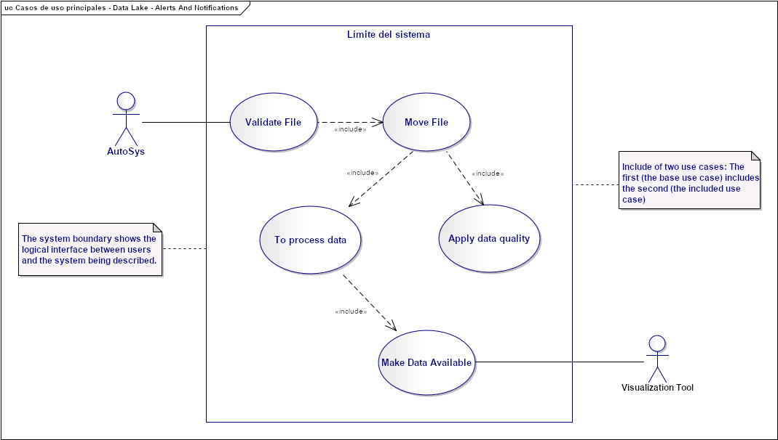
Needs and Solution Proposal (IX)
Data Lake - Fraud Control – Use Case View
Validate File:
Move File:
Top process data:
Apply data quality:
Make Data Available
1.
2.
3.
4.
5.

Slide 17
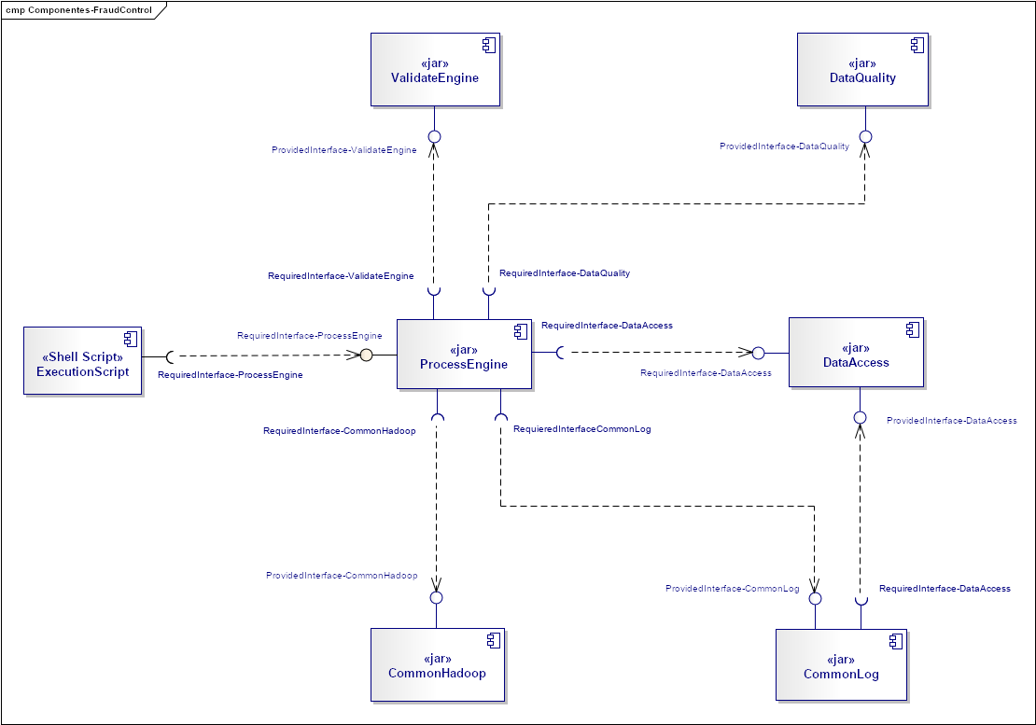
Needs and Solution Proposal (X)
New component
Component to modify
Data Lake - Fraud Control - Component View
ProcessEngine: It is the component that is in charge of orchestrating the project flow of Fraud Control, It is contemplated that this component can handle projects with a similar casuistry (validate existence and structure files, attend to files delimited by a character, data quality, move to a curated area and create views to be consumed by visualization tools)
ValidationEnginie: It is the component that has the responsibility to perform the functionality of validating the structures of the events, it is contemplated to scale the component for validations in different projects, allowing reuse.
DataAccess: It is the component that has the responsibility to provide a common interface for access to different resources, both Hadoop and outside the Data Lake
CommandHadoop: It is the component that is responsible for providing a common interface to execute Hadoop commands
Shell-Script: It is the component that has the responsibility to execute the component "ProcessEngine”
DataQuality: It is the component that is responsible for satisfying the Data Quality requirements
CommonLog: It is the component that is responsible for monitoring the flow of customers who request it (components)
6.
2.
5.
3.
1.
4.
7.

Slide 18
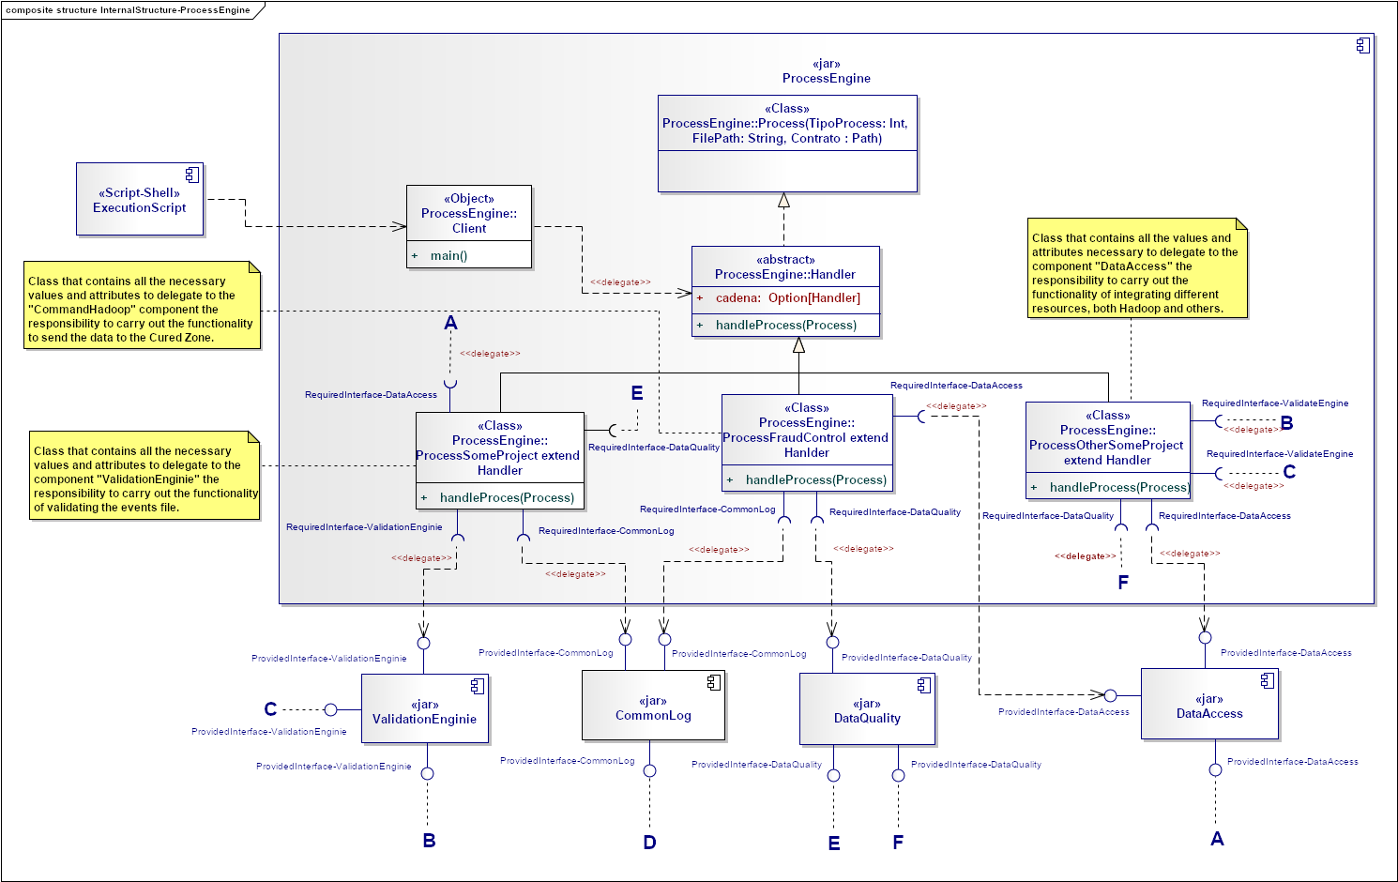
Needs and Solution Proposal (XI)
New component
Component to modify
Component not contemplated
Data Lake - Fraud Control - Component View II - ProcessEngine Internal structure
Component scaling is contemplated by extending the Handler class
Component scaling is contemplated by extending the Handler class

Slide 19
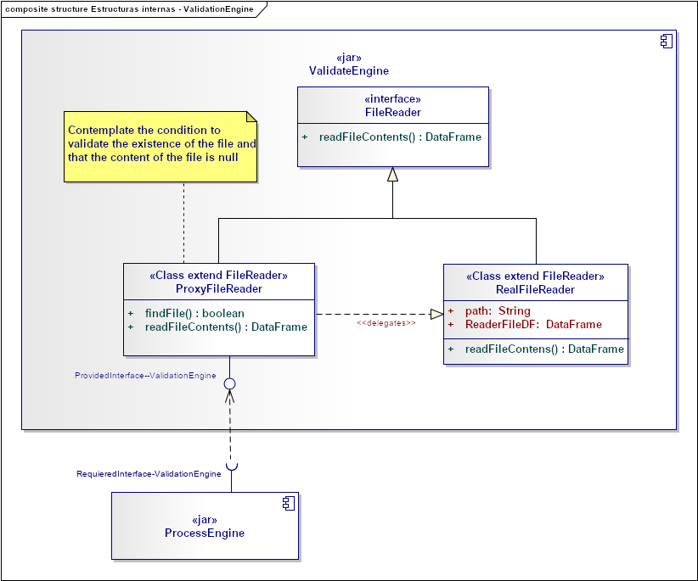
Needs and Solution Proposal (XII)
Data Lake - Fraud Control - Component View II - ValidationEngine Internal structure

Slide 20
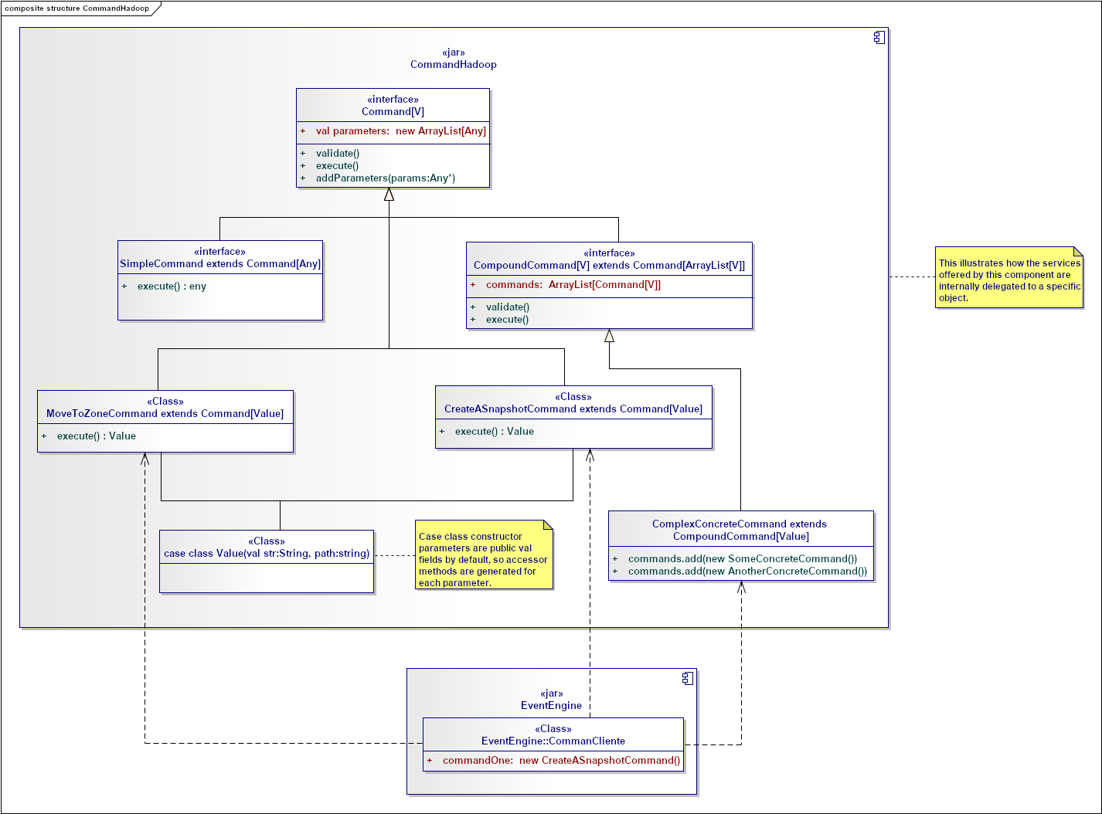
Needs and Solution Proposal (XIV)
Data Lake - Fraud Control - Component View II - CommandHadoop Internal structure

Slide 21
Needs and Solution Proposal (XV)
Data Lake - Fraud Control – Deployment view

Slide 22
Infrastructure and Connectivity

Slide 23
Infrastructure and Connectivity (I)
Resumen de Componentes de Infraestructura
Infrastructure component | Description | Applicability (New, Modified, Unmodified) | Application in which the component is located
Pendiente | Pendiente | Pendiente | Pendiente

Slide 24
Volumetría (I)
Case of use -
Characteristic | Detalle

Slide 25
Servicios Generales (I)
Seguridad
El detalle de los lineamientos mencionados están definidos en los documentos:
Standards for the creation of topics, development and security
Confidencialidad
Communication through mutual authentication and Kerberos between Data Lake
Auditoria:
Sending Logs to the Error Topic

Slide 26
Risks and Dependencies (I)
Coexistence
The detail of the mentioned guidelines are defined
Validate the integration standards with Data Lake, with Data Governance
Risks
El detalle de los lineamientos mencionados están definidos en los documentos:
Concept tests to integrate Kerberos between Data Lake

Slide 27
Risks and Dependencies (II)
Dependencias
El detalle de los lineamientos mencionados están definidos en los documentos:
Standard of Security Controls in Data Lake

Slide 28
Standards, Patterns and Decisions of Architecture (I)
Exceptions to Standards and Architecture Patterns
Pendiene

Slide 29
Standards, Patterns and Decisions of Architecture (II)
Architecture Decisions
Decisión | Premisas | Razonamiento de la Decisión
Pendienyte | Pendiente | Pendiente

Slide 30
Standards, Patterns and Decisions of Architecture (III)
Outbuildings
Dependencia | Componente externo a la solución que impacta | Fecha estimada en la que se requiere disponible
Not apply | Not apply | Not apply

Slide 31
References and Annex (I)
References
Nombre y version | Fecha | Comentarios | Rol/Departamento
https://docs.cloudera.com/documentation/enterprise/5-14-x/topics/impala_hbase.html | No Aplica | Cloudera Documentation | No Aplica
http://hbase.apache.org/book.html#datamodel | No Aplica | Hbase Documentation | No Aplica
https://docs.cloudera.com/documentation/enterprise/5-5-x/topics/impala_complex_types.html | No Aplica | Cloudera Documentation | No Aplica

